Slide 1


Individual project
2020 The USA Presidential election analysis
Chen Wang

Slide 2
Agenda
Data introduction and cleaning
Finding
Why did GOP 2020 lose their election?
Where are the third candidate?
How the age’s distribution tell us?
How the ethnicity tell us?
Linear regression model – Rate for Biden V.S Rate for Trump
Gender V.S. Rate V.S Vote
Conclusion

Slide 3
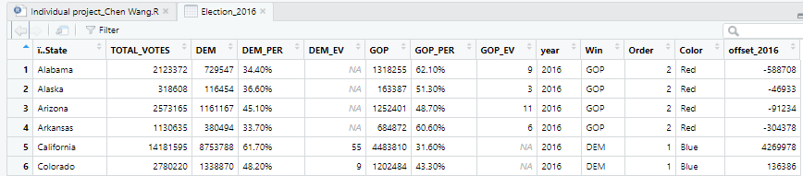
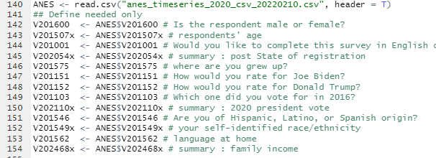
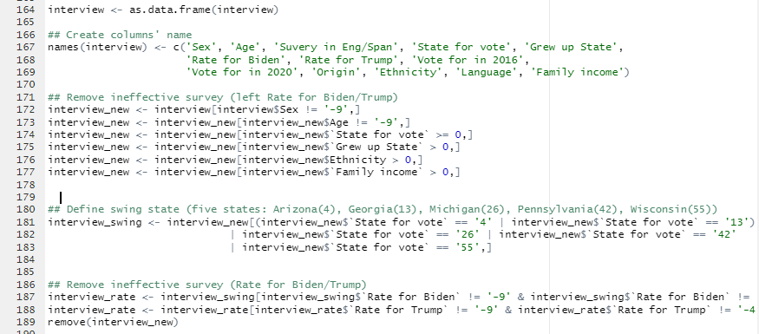
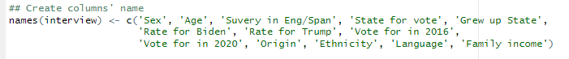
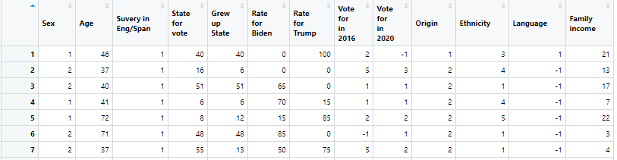
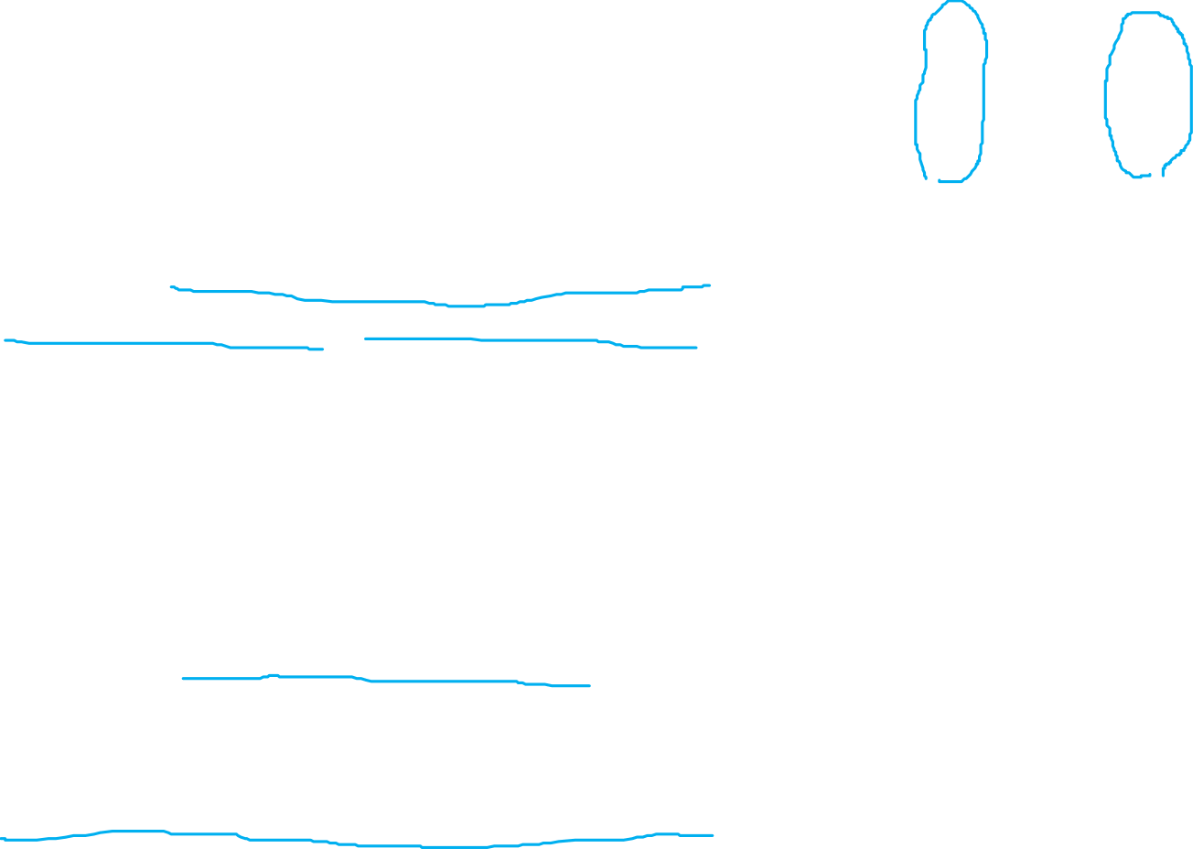
Datasets introduction
Election_2016, Election_2020:
https://www.fec.gov/introduction-campaign-finance/election-and-voting-information/
From the Federal Election Commission
DEM = Democrat ; GOP = Republican
Add color column group by party
Combine two similar datasets
ANES :
https://electionstudies.org/data-center/2020-time-series-study/
From American National Election Studies
Pick up: keep needed columns
Naming: Name column names
Removing: Remove ineffective rows
Separate into different tables by state

Slide 4
Finding

Slide 5
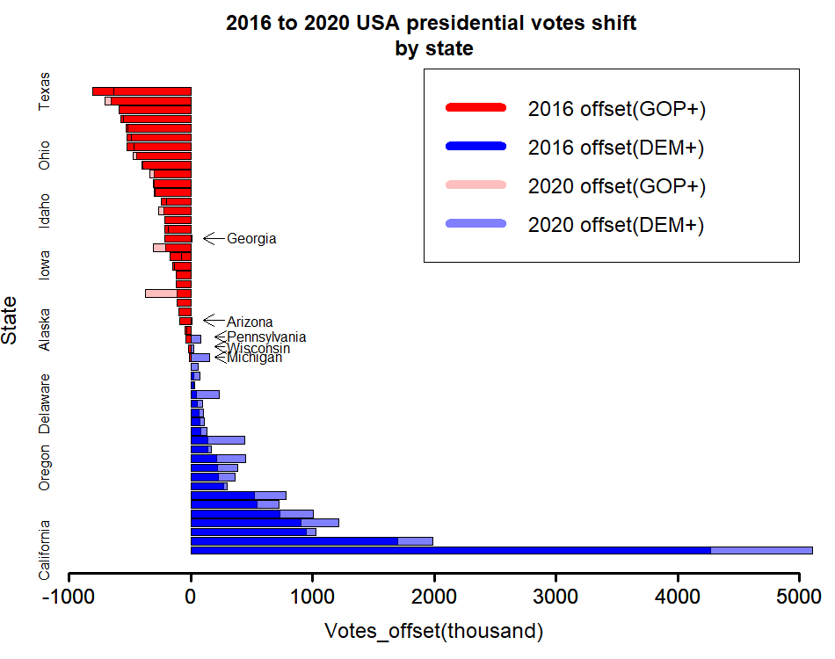
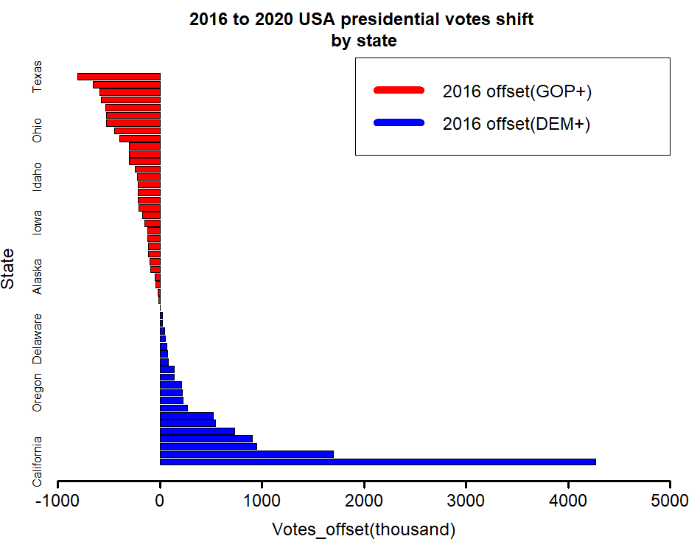
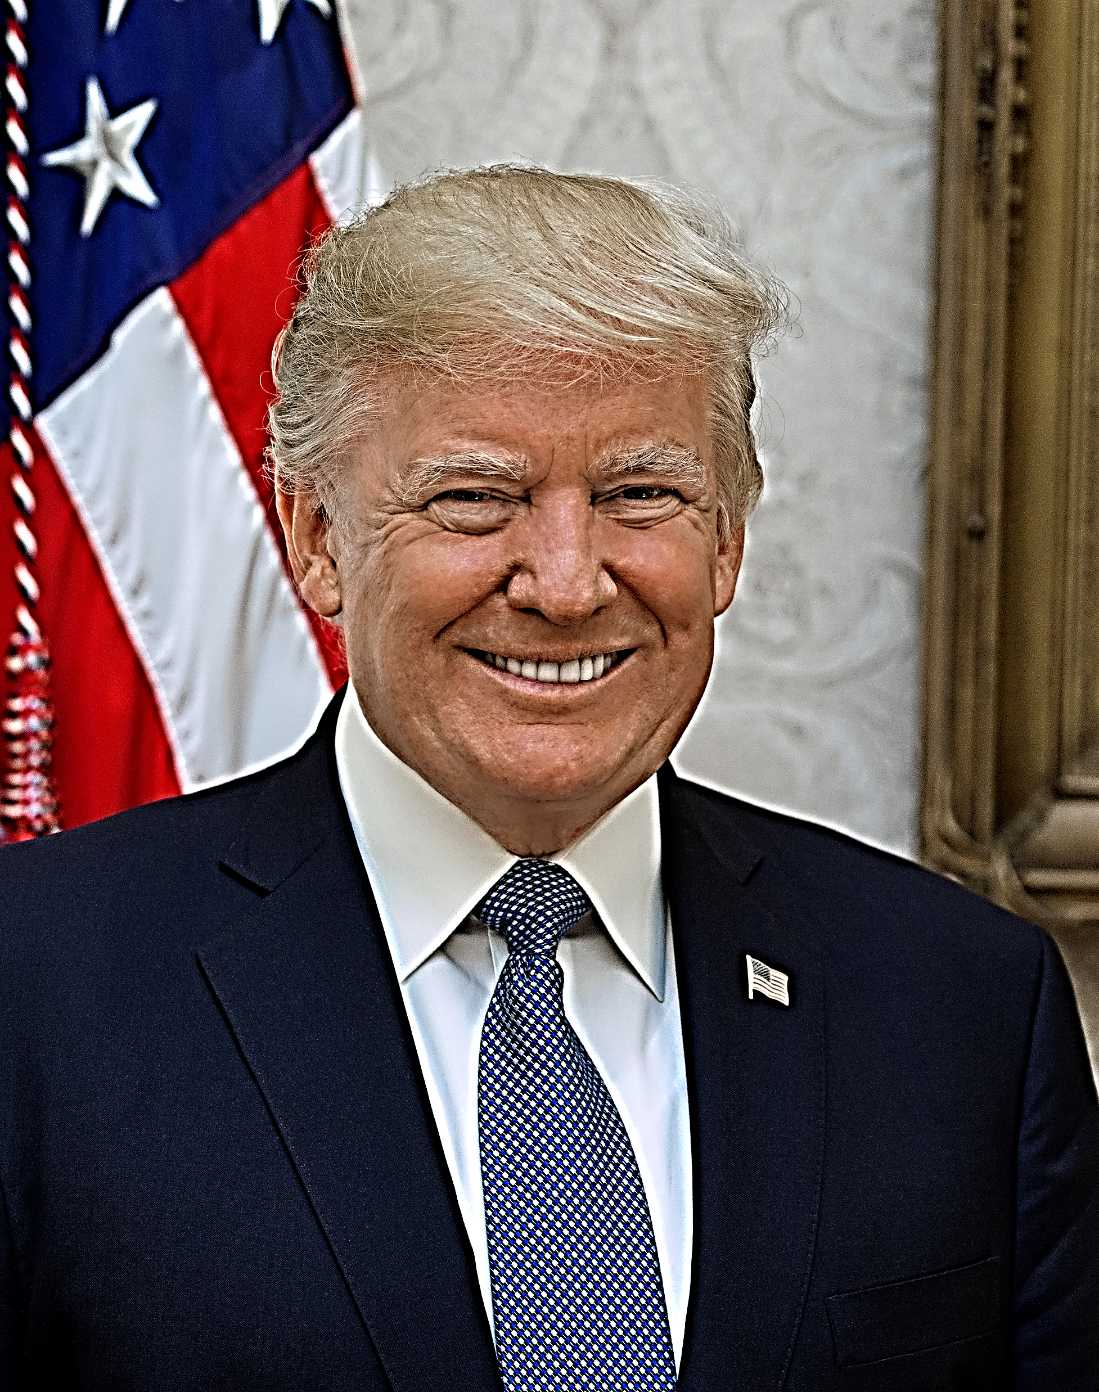
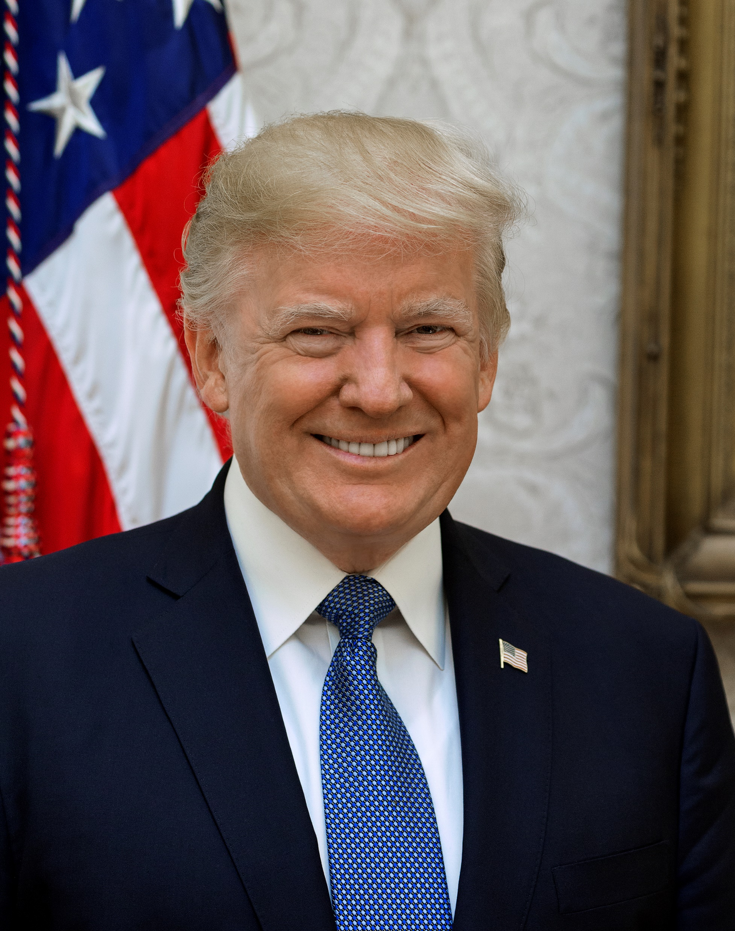
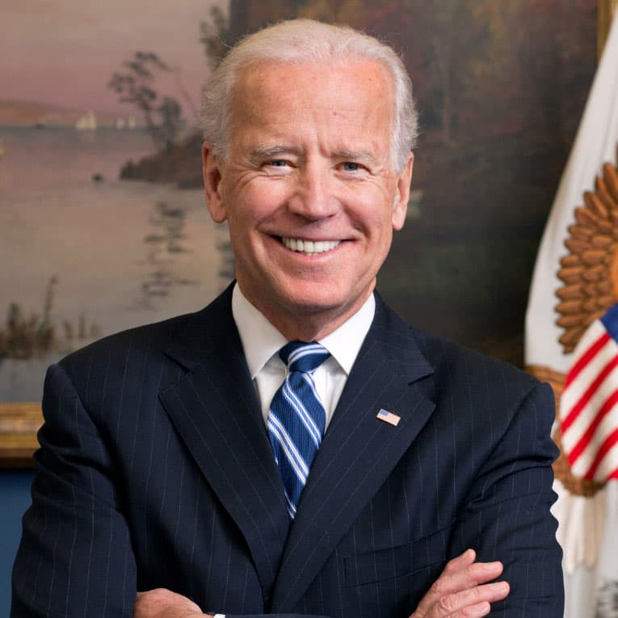
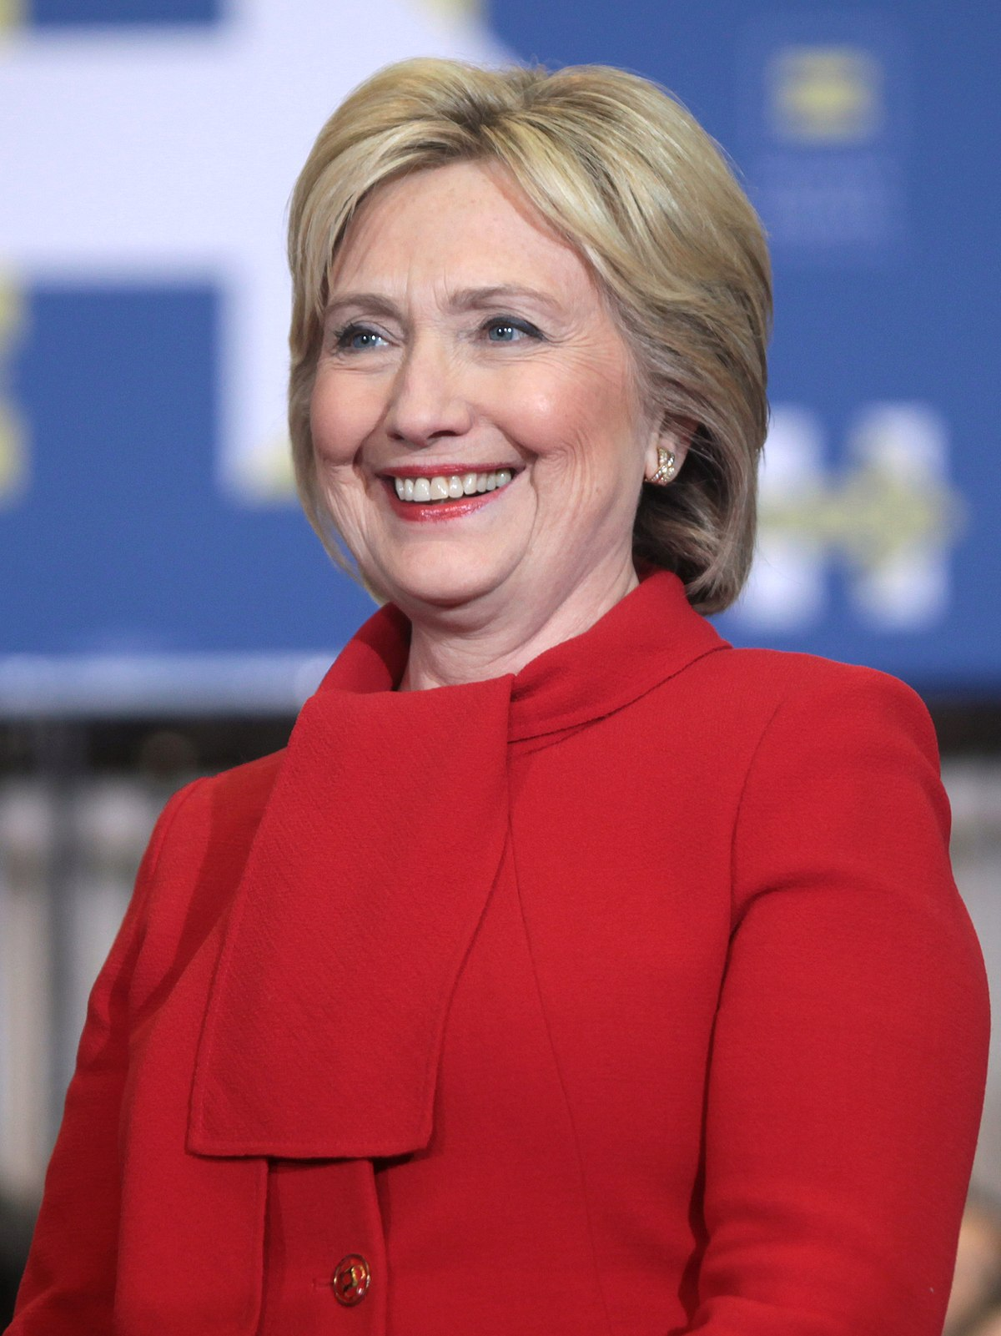
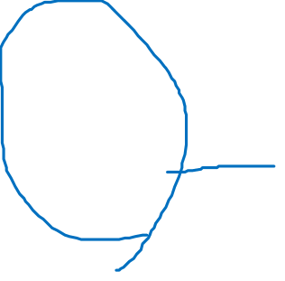
Finding 1. : Why did GOP 2020 lose their election?
2020
DEM
2020 GOP Bias ↑
Five states have overturned (GOP→DEM)
2016
DEM
232
279
306
204
2020
GOP
2016
GOP

Slide 6
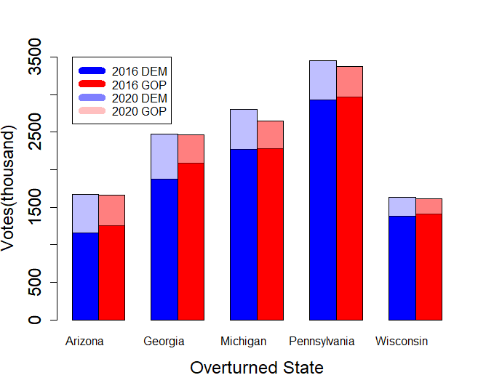
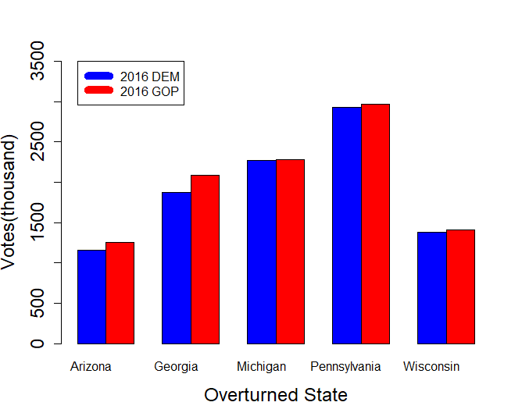
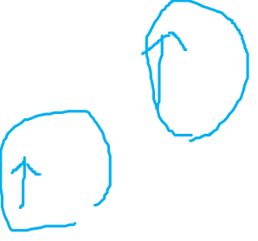
Finding 2. : Why did GOP 2020 lose their election?
Both have higher votes in 2020
But DEM increase more than GOP

Slide 7
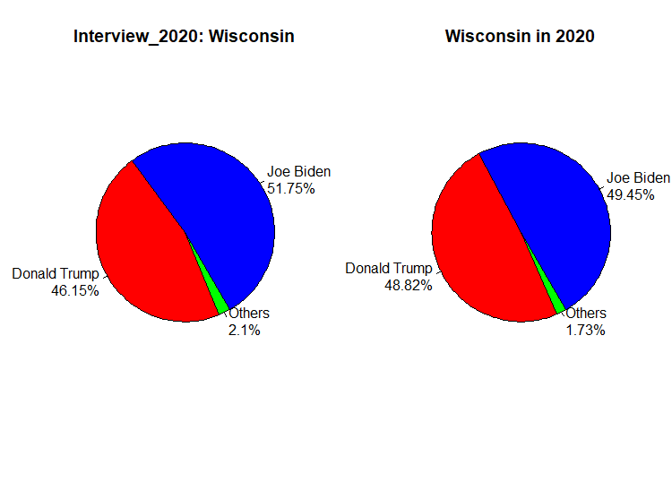
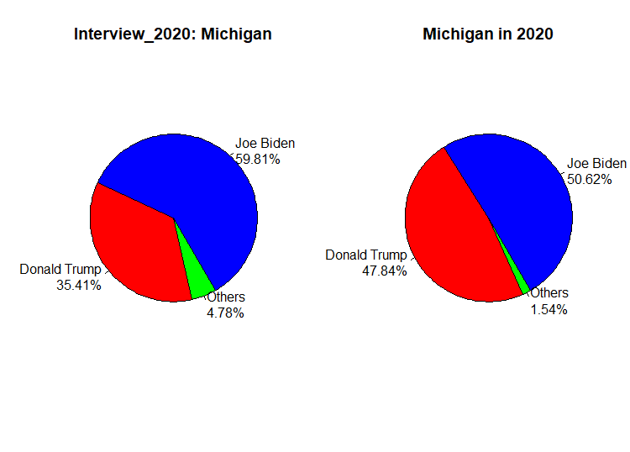
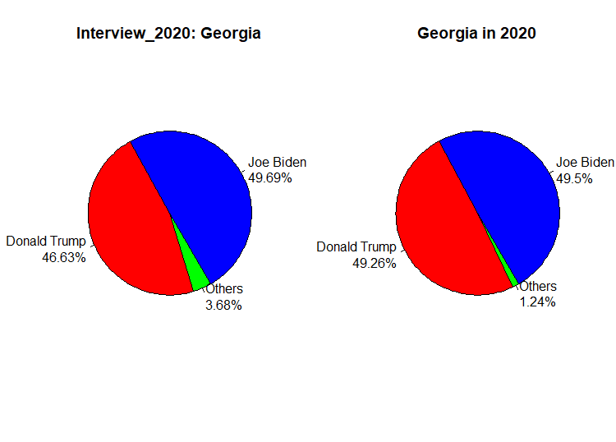
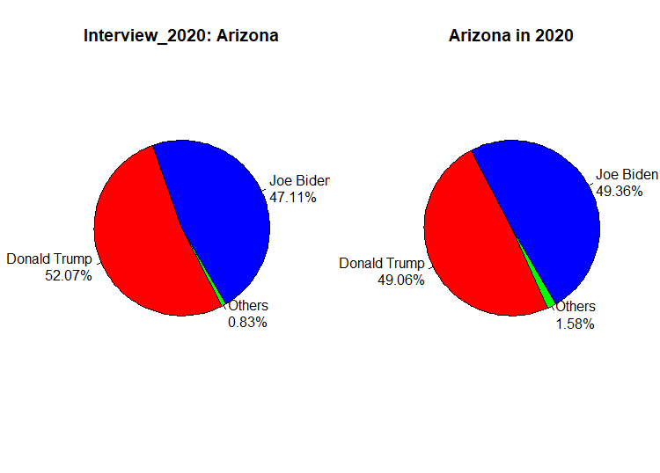
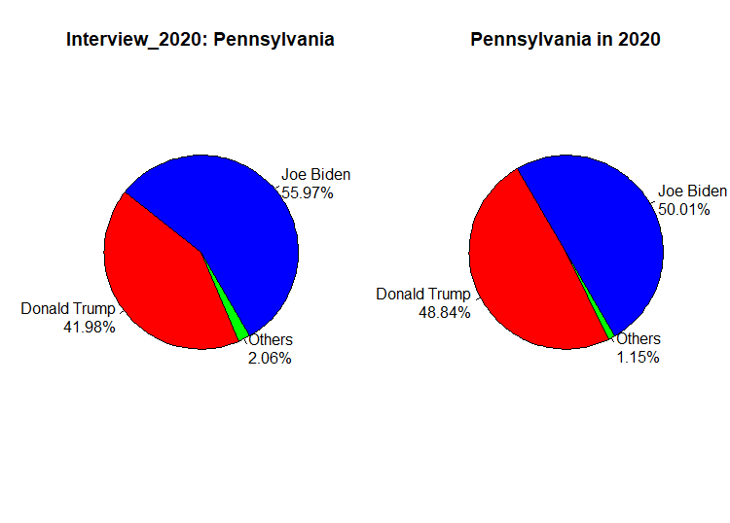
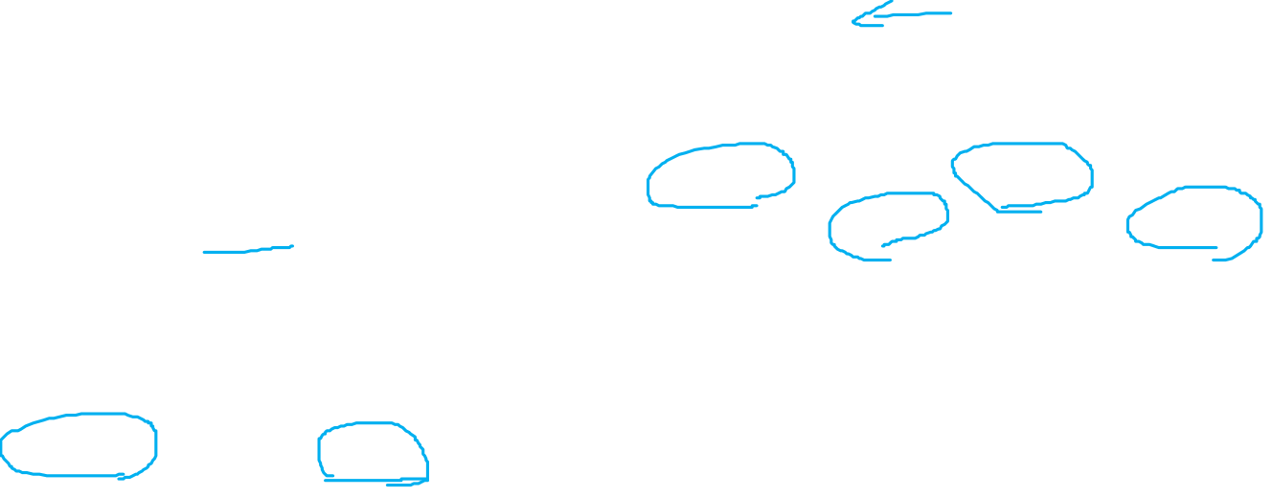
Finding 3. : Where are the third candidate?

Slide 8
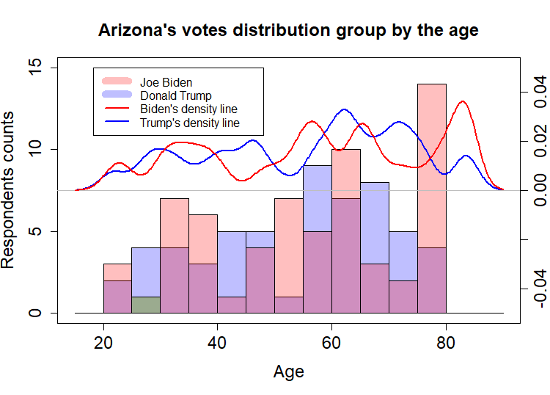
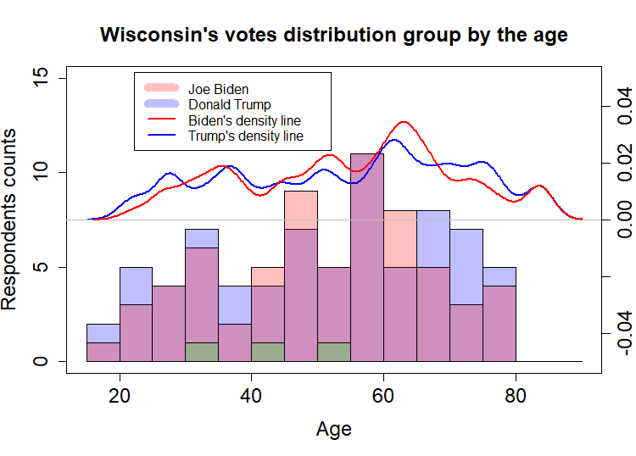
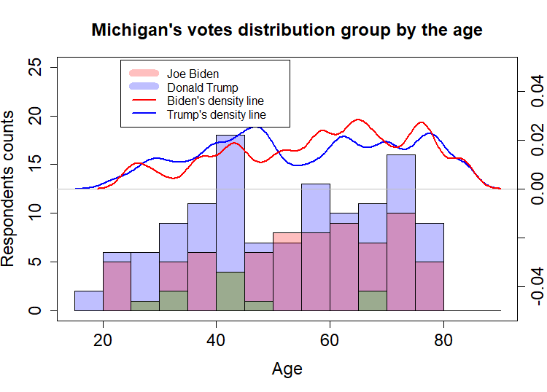
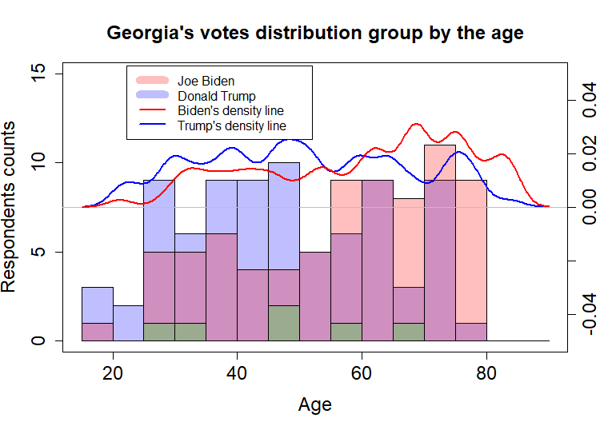
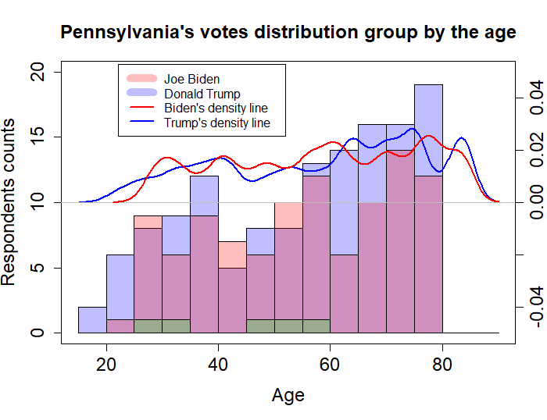

Finding 4. : How the age distribution tell us?
Age ↑, support Biden more

Slide 9
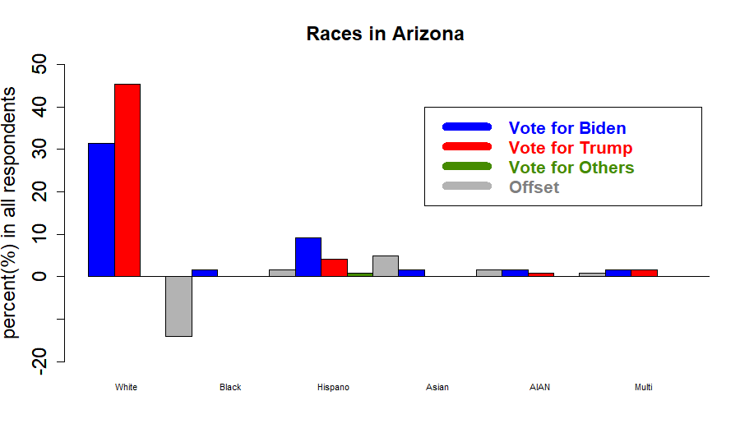
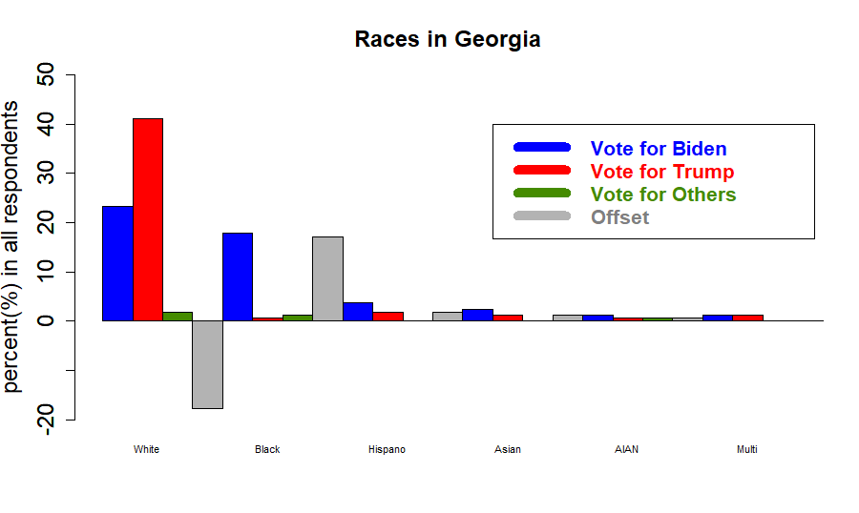
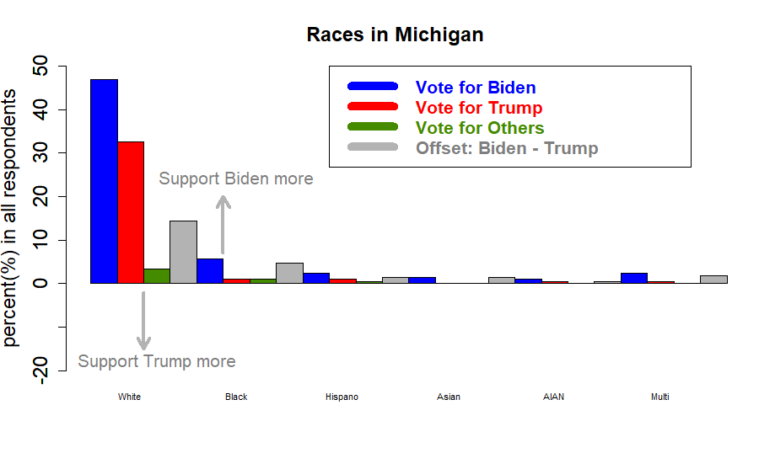
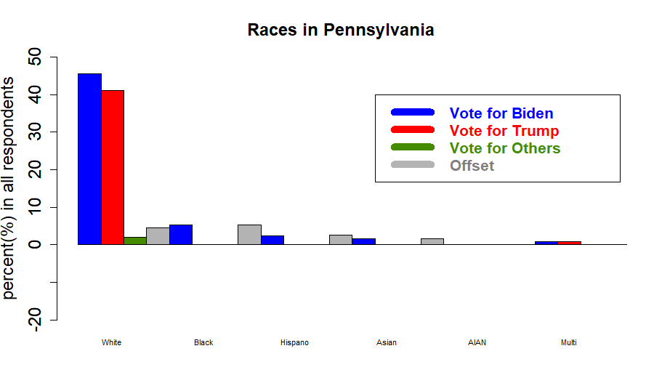
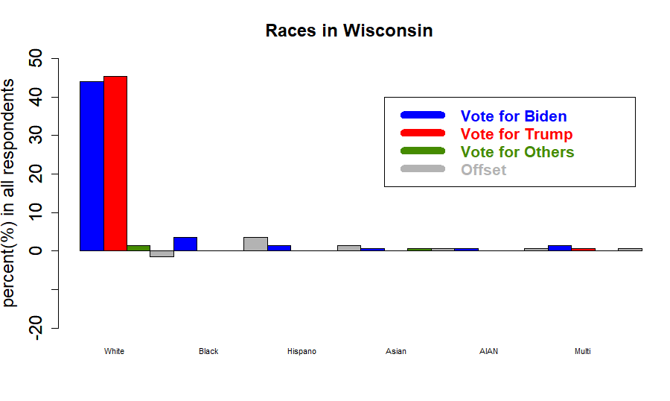
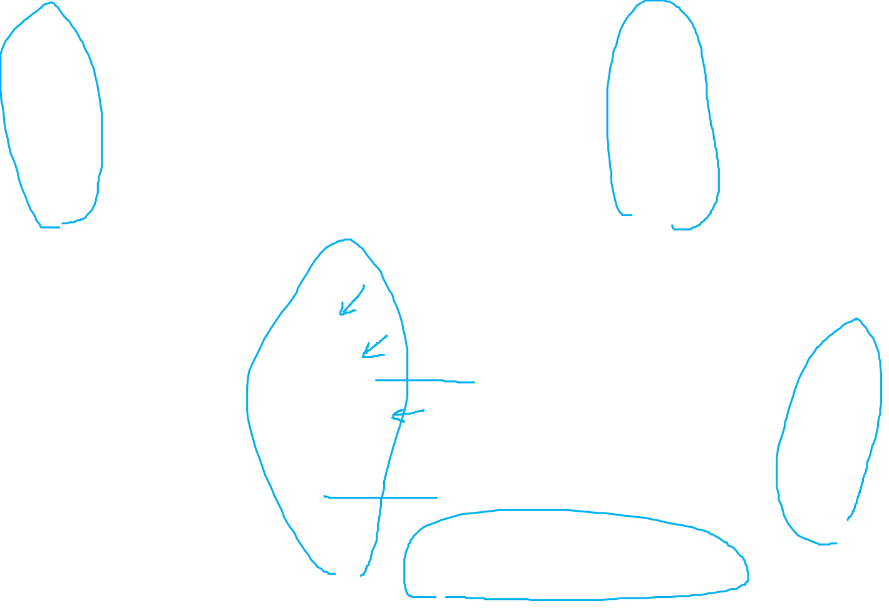
Finding 5. : How the ethnicity tell us?
White
Hispanic
AIAN
Black
Asian
Multi-races

Slide 10
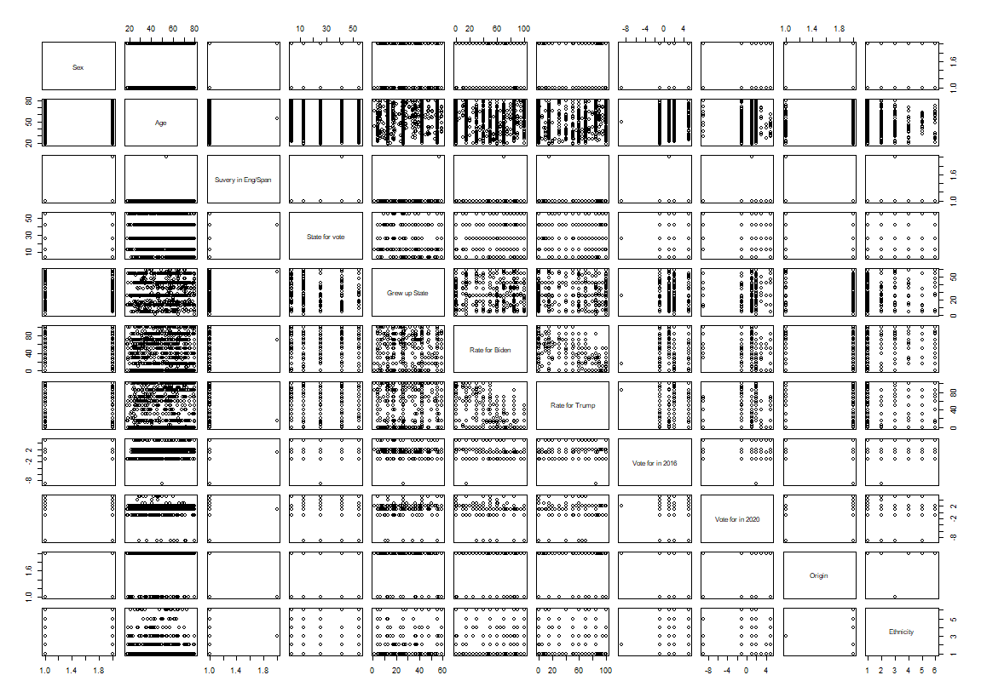

Appendix: Correlation
Predictable

Slide 11
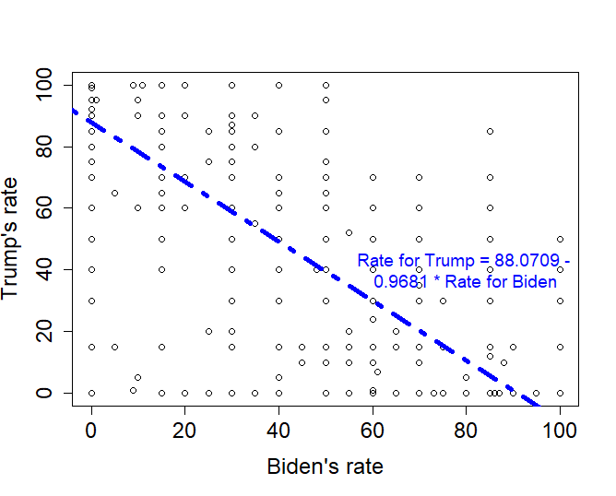
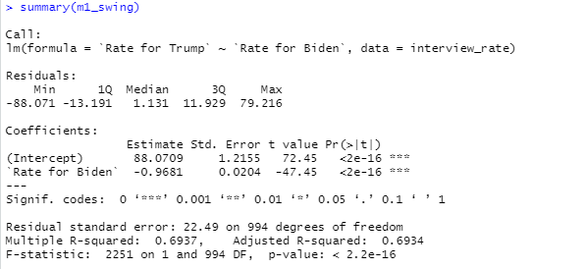

Appendix: Linear regression (merge all overturned state)

Slide 12
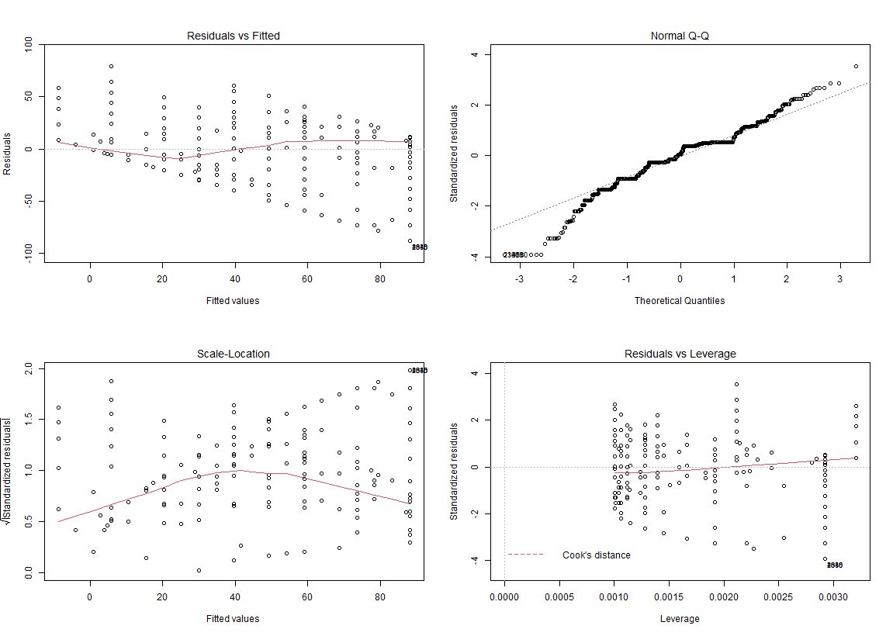

Appendix: Linear regression (overturned state)

Slide 13
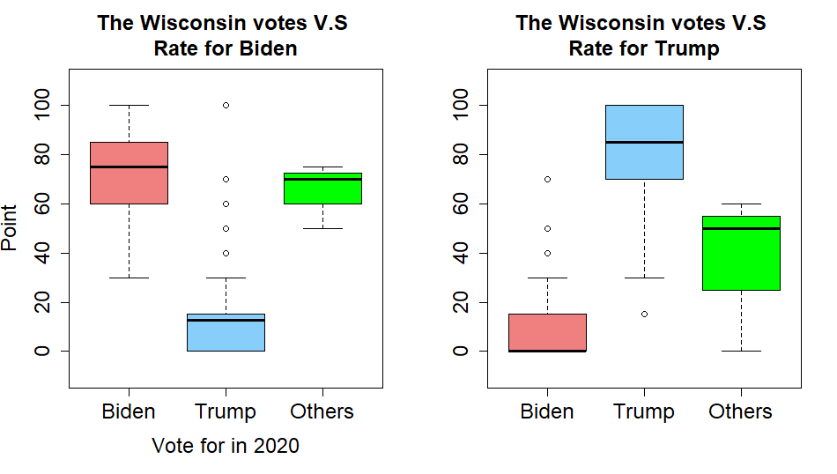
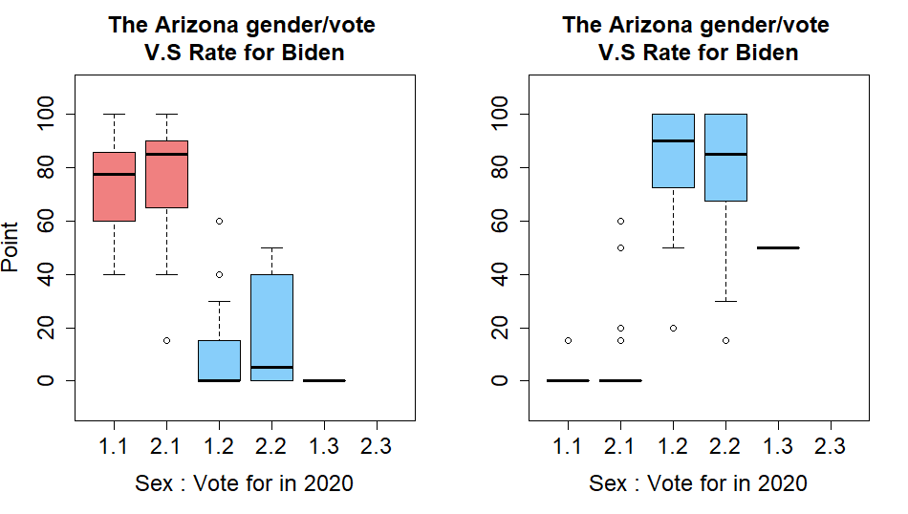
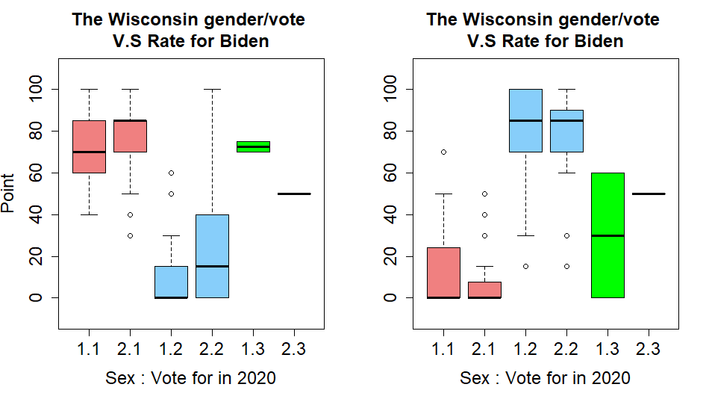
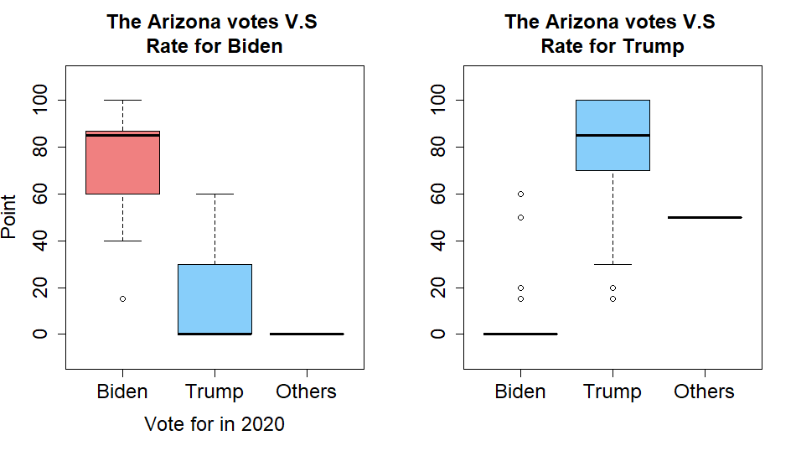
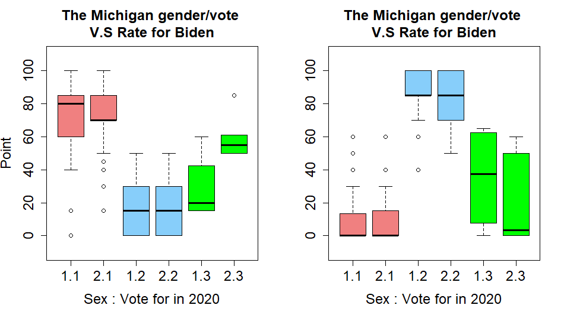
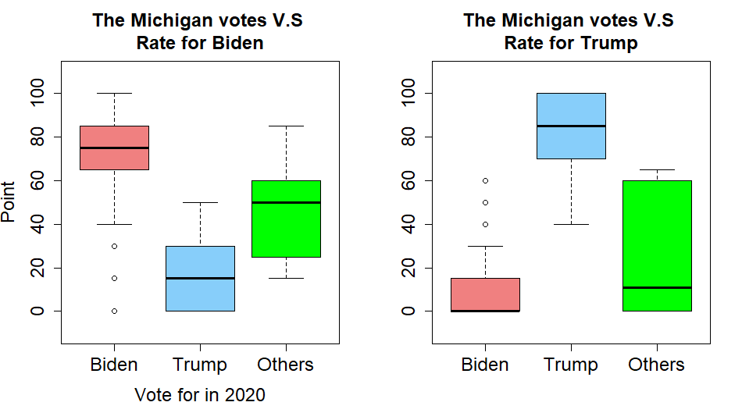
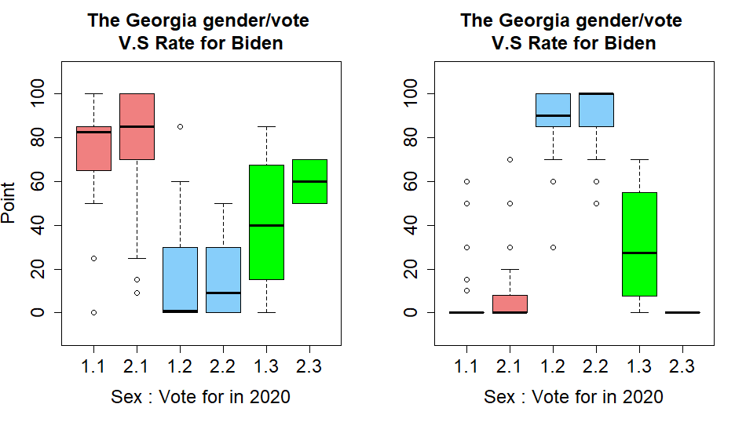
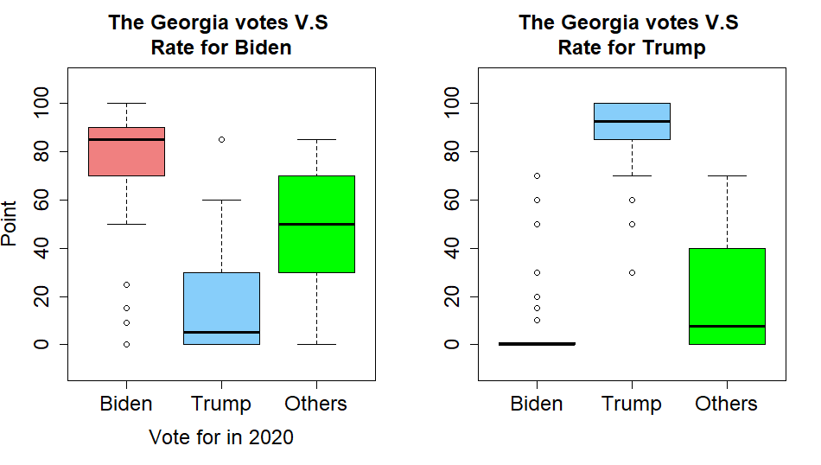
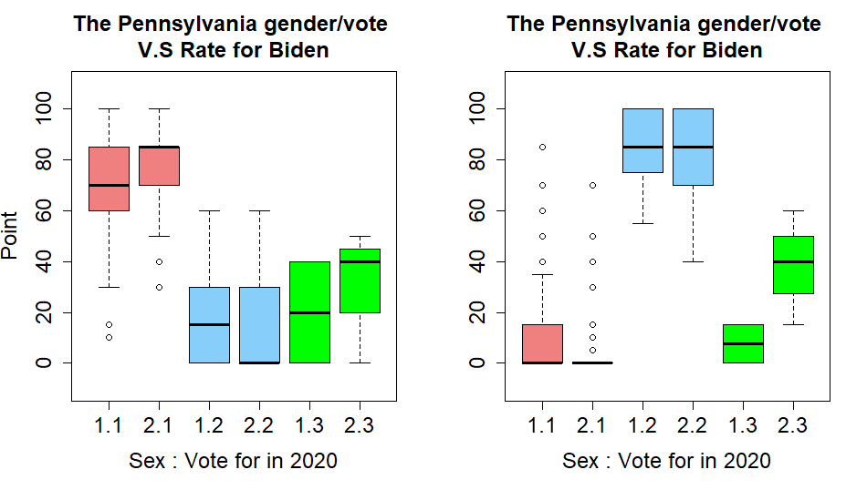
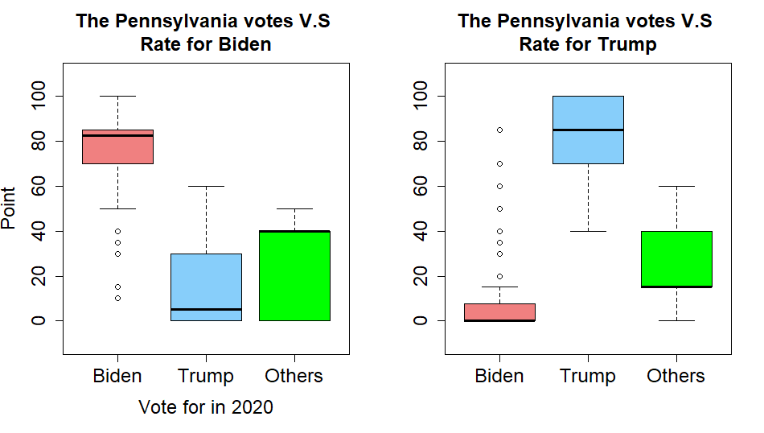
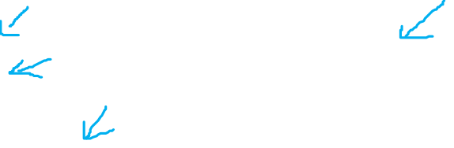
Appendix: Gender V.S Rate)
1.1 = Male/Biden
2.1 = Female/Biden
1.2 = Male/Trump
2.2 = Female/Trump

Slide 14
Conclusion
Five states have overturned their preferred tendency.
Both parties (DEM & GOP) have a higher vote in 2020, but DEM’s vote is more significant.
Votes for the third candidate change their mind.
DEM(Biden) has a better supporting in the older people.
DEM takes advantage of all the ethnicities except white American.

